Slide 1
Body Age Prediction from Body Features
Skylar Wurster

Slide 2
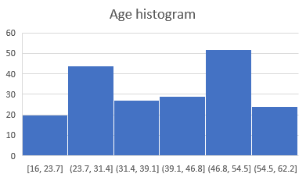
Preliminary Analysis
Age histogram shows many more instances for age between 46 and 55 and between 23 and 32, this may cause a model to gravitate toward those age ranges
SSBP and DSBP show a somewhat uniform distribution. Some entries do not have a reading for one or multiple values and are dropped.
Waist to hip ratio is evenly distributed, but may not be a good indicator of body age.

Slide 3
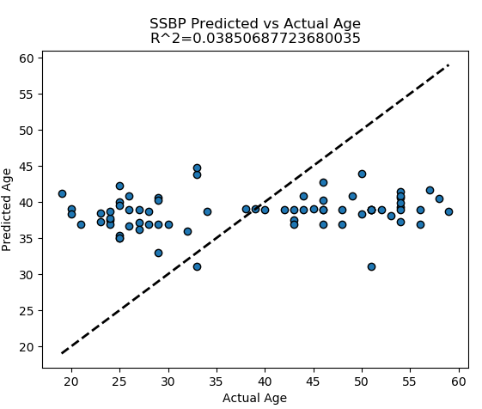
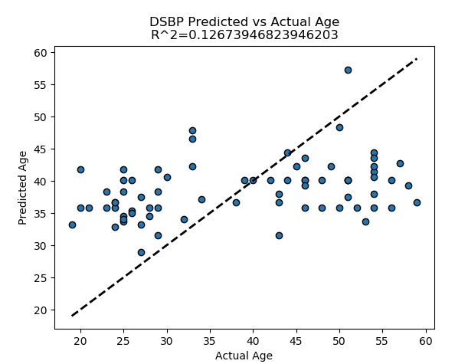
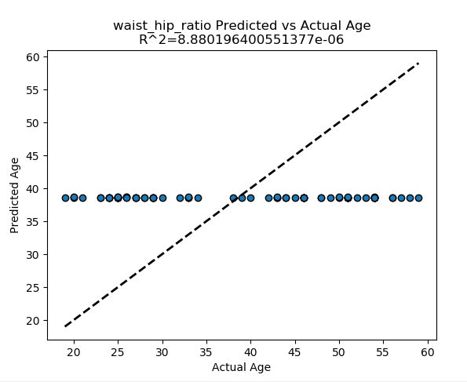
Single Variable Analysis(Linear)

Slide 4
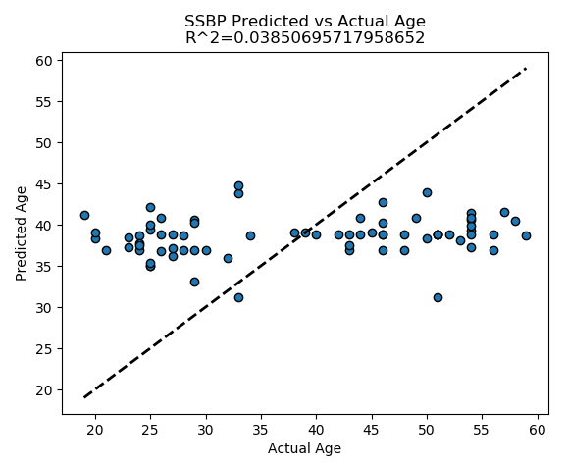
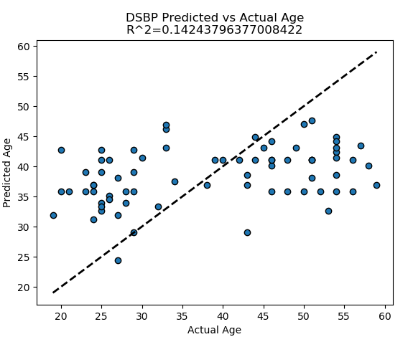
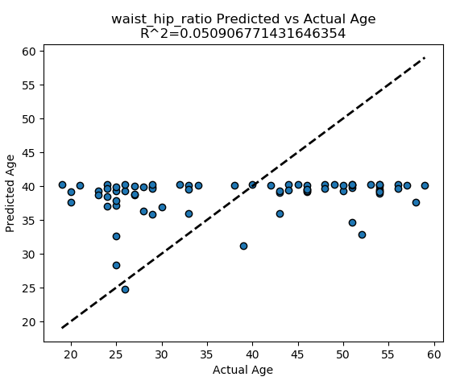
Single Variable Analysis(deg=2)

Slide 5
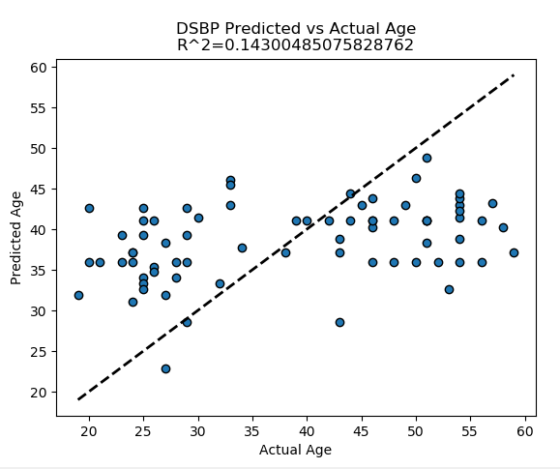
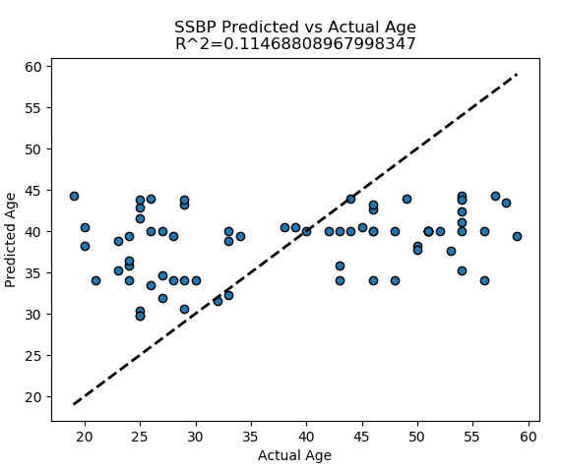
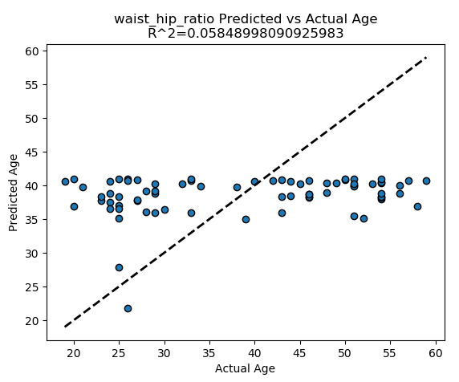
Single Variable Analysis(deg=3)

Slide 6
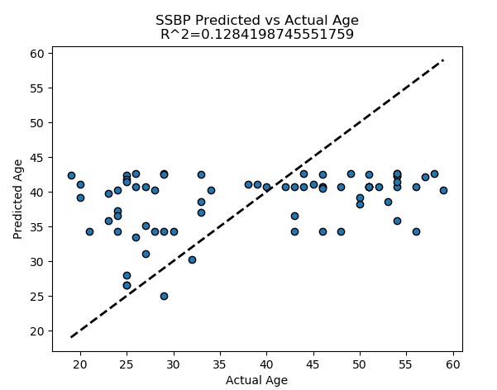
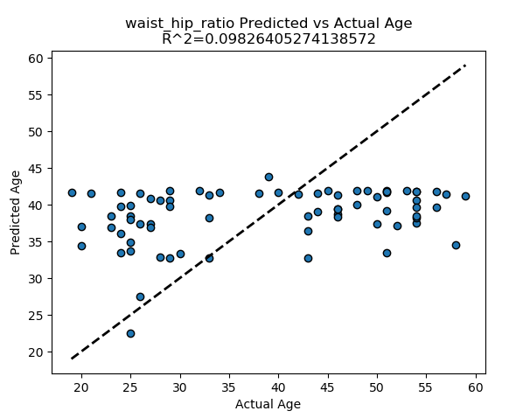
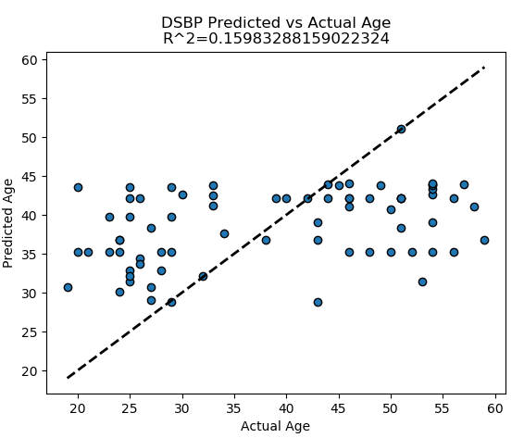
Single Variable Analysis(deg=5)

Slide 7
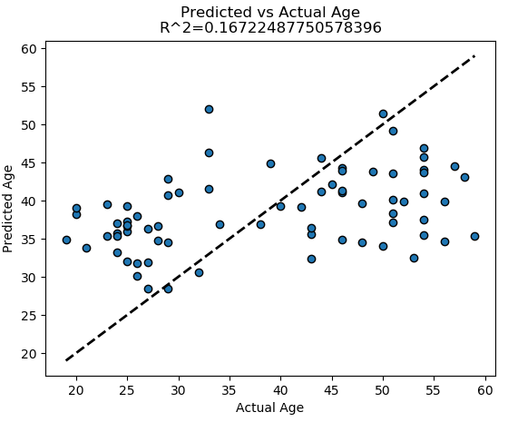

Age prediction – Linear Regression

Slide 8
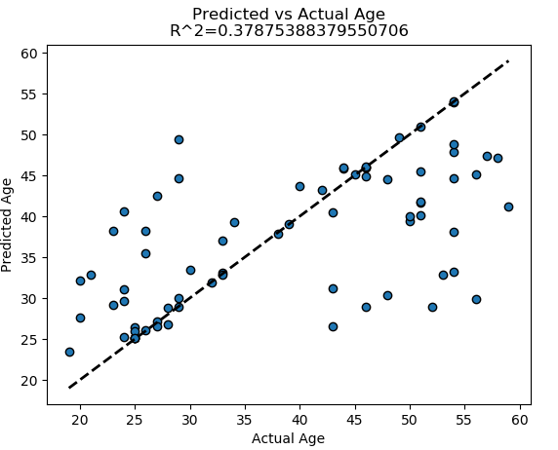

Age prediction – SVM with RBF kernel

Slide 9
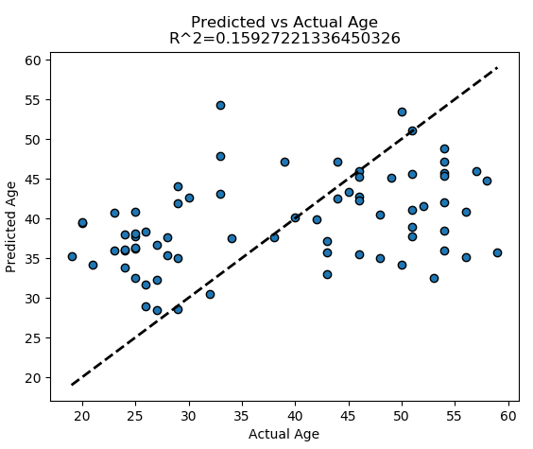

Age prediction – SVM linear

Slide 10
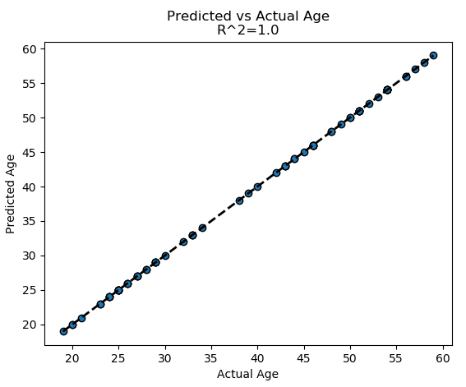

Age prediction – Decision Tree Regressor

Slide 11
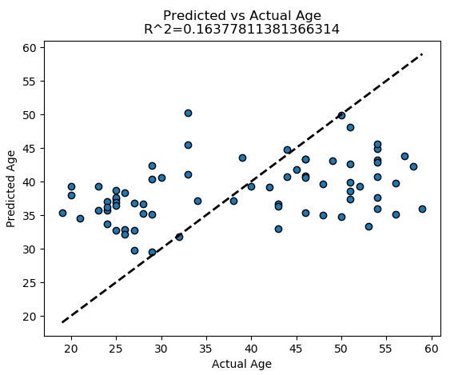

Age prediction – Ridge

Slide 12
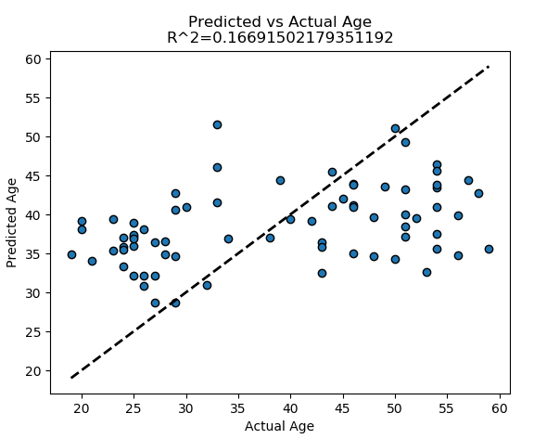

Age prediction – Lasso

Slide 13
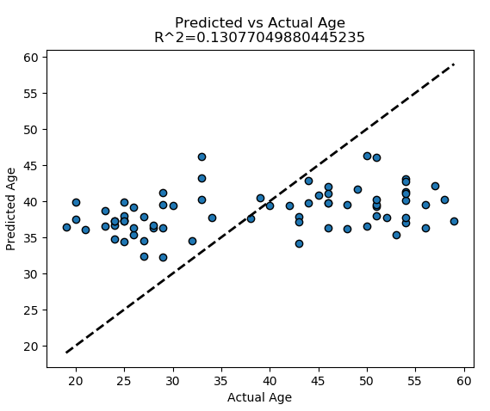

Age prediction – ElasticNet

Slide 14
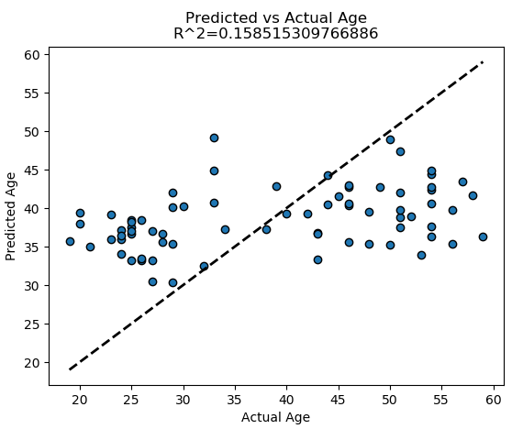

Age prediction – BayesianRidge

Slide 15
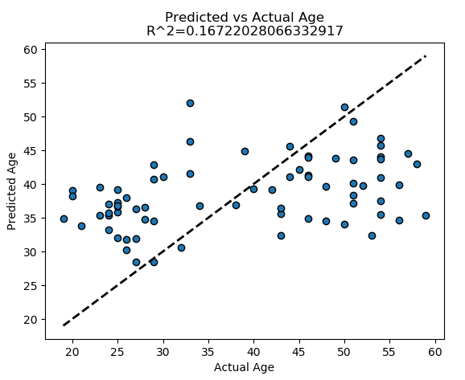

Age prediction – SGD Regressor

